Slide 1
Chapter 9 Sorting

Slide 2
what data to sort?
The data to be sorted might be integers, doubles, characters, or objects. For simplicity, this chapter assumes:
data to be sorted are integers,
data are stored in a list, and
data are sorted in ascending order

Slide 3
Insertion Sort
myList = [2, 9, 5, 4, 8, 1, 6] # Unsorted
The insertion sort algorithm sorts a list of values by repeatedly inserting an unsorted element into a sorted sublist until the whole list is sorted.

Slide 4
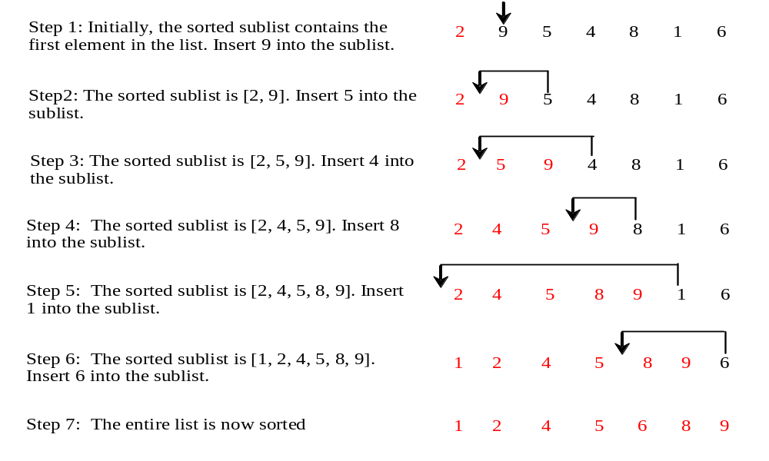
Insertion Sort
myList = [2, 9, 5, 4, 8, 1, 6] # Unsorted

Slide 5
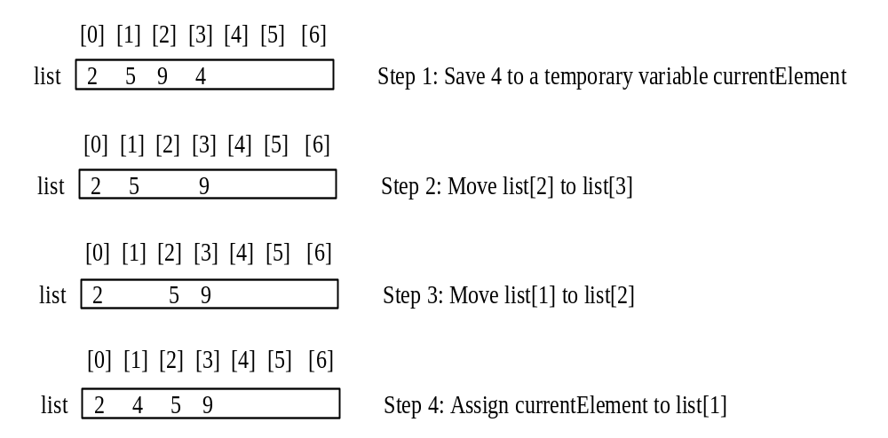
How to Insert?

Slide 6
From Idea to Solution
# The function for sorting elements in ascending order
def insertionSort(lst):
for i in range(1, len(lst)):
# insert lst[i] into a sorted sublist lst[0..i-1] so that
# lst[0..i] is sorted.
currentElement = lst[i]
k = i - 1
while k >= 0 and lst[k] > currentElement:
lst[k + 1] = lst[k]
k -= 1
# Insert the current element into lst[k + 1]
lst[k + 1] = currentElement
def main():
list = [2, 3, 2, 5, 6, 1, -2, 3, 14, 12]
insertionSort(list)
for v in list:
print(v, end = " ")
main()

Slide 7
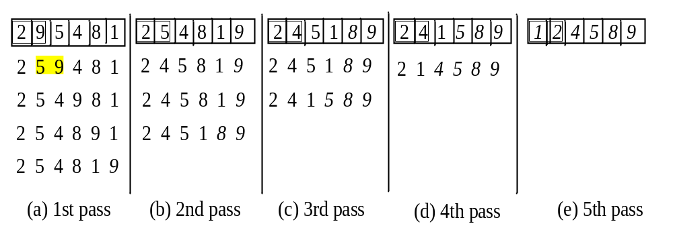
Bubble Sort
Given an unordered list, we compare adjacent elements in the list, each time, putting in the right order of magnitude, only two elements. The algorithm hinges on a swap procedure.

Slide 8
From Idea to Solution
def bubbleSort(lst):
needNextPass = True
k = 1
while k < len(lst) and needNextPass:
# List may be sorted and next pass not needed
needNextPass = False
for i in range(len(lst) - k):
if lst[i] > lst[i + 1]:
# swap lst[i] with lst[i + 1]
temp = lst[i]
lst[i] = lst[i + 1]
lst[i + 1] = temp
needNextPass = True # Next pass still needed
k += 1
return lst
def main():
lst = [2, 3, 2, 5, 6, 1, -2, 3, 14, 12]
bubbleSort(lst)
for v in lst:
print(v, end = " ")
main()

Slide 9
Merge Sort
The merge sort algorithm is based on the divide and conquer rule. Given a list of unsorted elements, we split the list into approximately two halves. We continue to divide the two halves recursively. After a while, the sublists created as a result of the recursive call will contain only one element. At that point, we begin to merge the solutions in the conquer or merge step.

Slide 10
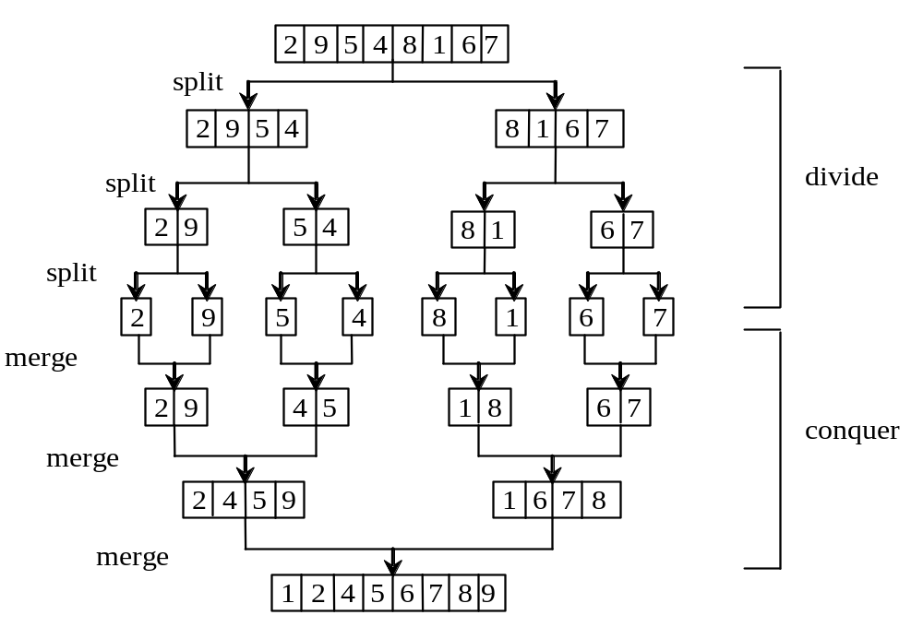
Merge Sort

Slide 11
From Idea to Solution
def mergeSort(list):
if len(list) > 1:
# Merge sort the first half
firstHalf = list[ : len(list) // 2]
mergeSort(firstHalf)
# Merge sort the second half
secondHalf = list[len(list) // 2 : ]
mergeSort(secondHalf)
# Merge firstHalf with secondHalf into list
merge(firstHalf, secondHalf, list)
def main():
list = [2, 3, 2, 5, 6, 1, -2, 3, 14, 12]
mergeSort(list)
for v in list:
print(v, end = " ")
main()

Slide 12
# Merge two sorted lists */
def merge(list1, list2, temp):
current1 = 0 # Current index in list1
current2 = 0 # Current index in list2
current3 = 0 # Current index in temp
while current1 < len(list1) and current2 < len(list2):
# If the current element in list1 is smaller
if list1[current1] < list2[current2]:
temp[current3] = list1[current1]
current1 += 1
current3 += 1
else: # If the current element in list2 is smaller or equal
temp[current3] = list2[current2]
current2 += 1
current3 += 1
# Copy any remaining elements from list1 to temp
while current1 < len(list1):
temp[current3] = list1[current1]
current1 += 1 # Move to the next element in list1
current3 += 1 # Move to the next position in temp
# Copy any remaining elements from list2 to temp
while current2 < len(list2):
temp[current3] = list2[current2]
current2 += 1 # Move to the next element in list2
current3 += 1 # Move to the next position in temp

Slide 13
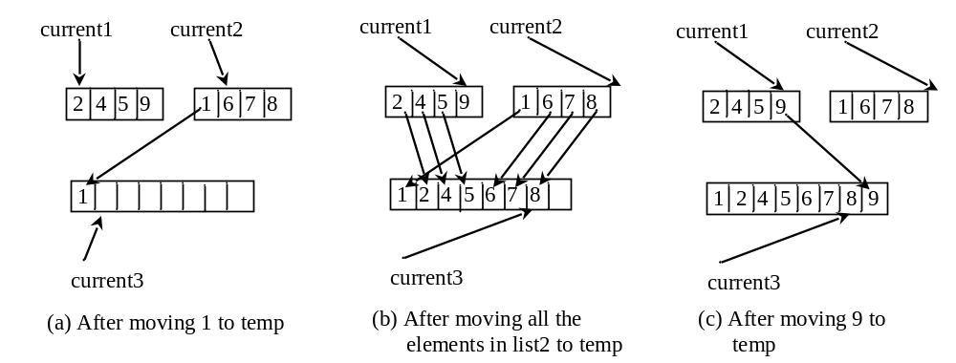
Merge Two Sorted Lists

Slide 14
Quick Sort
The algorithm selects an element, called the pivot, in the array. Divide the array into two parts such that all the elements in the first part are less than or equal to the pivot and all the elements in the second part are greater than the pivot.
Recursively apply the quick sort algorithm to the first part and then the second part.

Slide 15
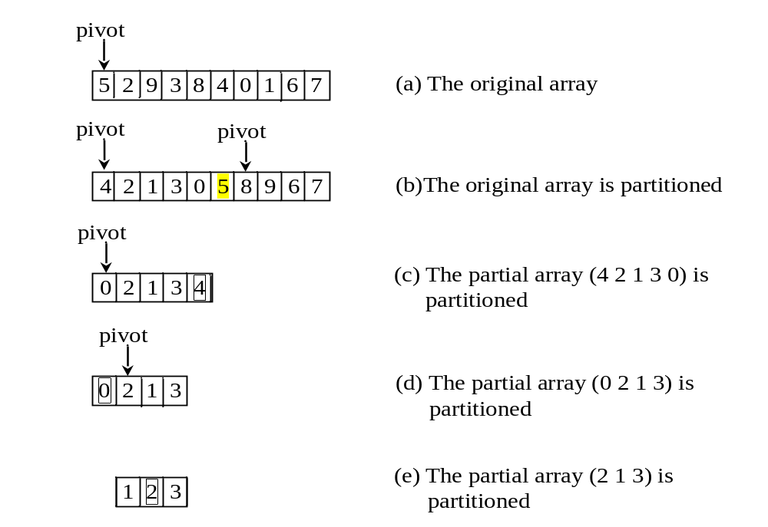
Quick Sort

Slide 16
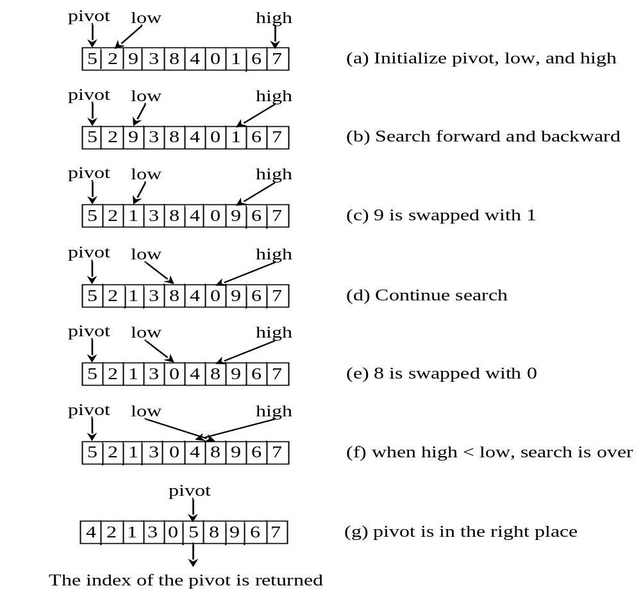
Partition

Slide 17
From Idea to Solution
def quickSort(lst):
quickSortHelper(lst, 0, len(lst) - 1)
def quickSortHelper(lst, first, last):
if last > first:
pivotIndex = partition(lst, first, last)
quickSortHelper(lst, first, pivotIndex - 1)
quickSortHelper(lst, pivotIndex + 1, last)
def main():
lst = [2, 3, 2, 5, 6, 1, -2, 3, 14, 12]
quickSort(lst)
for v in lst:
print(v, end = " ")
main()

Slide 18
def partition(lst, first, last):
pivot = lst[first] # Choose the first element as the pivot
low = first + 1 # Index for forward search
high = last # Index for backward search
while high > low:
# Search forward from left
while low <= high and lst[low] <= pivot:
low += 1
# Search backward from right
while low <= high and lst[high] > pivot:
high -= 1
# Swap two elements in the list
if high > low:
lst[high], lst[low] = lst[low], lst[high]
# Move `high` to the correct position for the pivot
while high > first and lst[high] >= pivot:
high -= 1
# Swap pivot with lst[high]
if pivot > lst[high]:
lst[first] = lst[high]
lst[high] = pivot
return high
else:
return first

Slide 19
Heap
Heap is a useful data structure for designing efficient sorting algorithms and priority queues. A heap is a binary tree with the following properties:
It is a complete binary tree.
Each node is greater than or equal to any of its children.

Slide 20
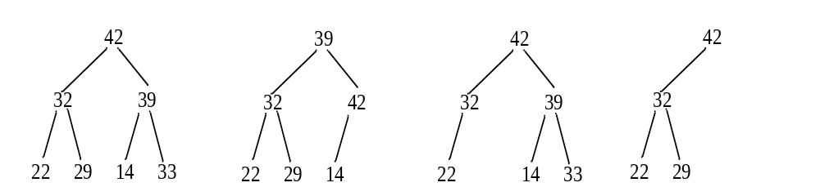
Complete Binary Tree
A binary tree is complete if every level of the tree is full except that the last level may not be full and all the leaves on the last level are placed left-most.
For example, in the following figure, the binary trees in (a) and (b) are complete, but the binary trees in (c) and (d) are not complete. Further, the binary tree in (a) is a heap, but the binary tree in (b) is not a heap, because the root (39) is less than its right child (42).
(a)
(b)
(c)
(d)

Slide 21
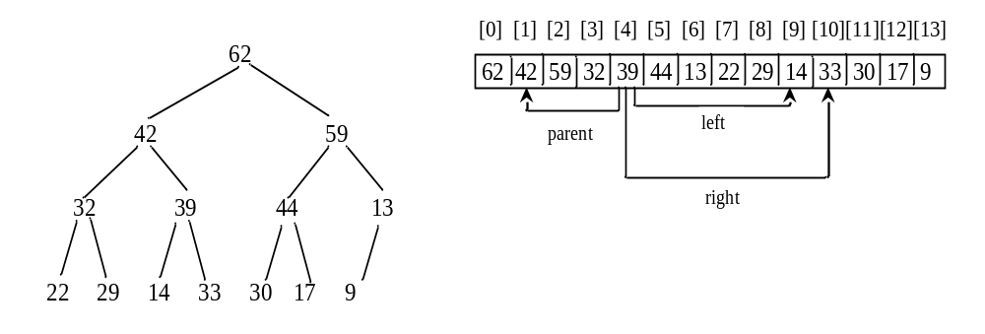
Representing a Heap
For a node at position i, its left child is at position 2i+1 and its right child is at position 2i+2, and its parent is (i-1)/2.
For example, the node for element 39 is at position 4, so its left child (element 14) is at 9 (2*4+1), its right child (element 33) is at 10 (2*4+2), and its parent (element 42) is at 1 ((4-1)/2).

Slide 22
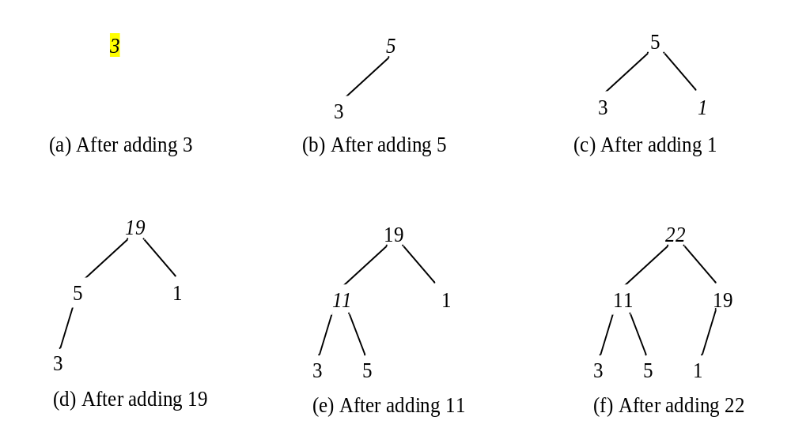
Adding Elements to the Heap
Adding 3, 5, 1, 19, 11, and 22 to a heap, initially empty

Slide 23
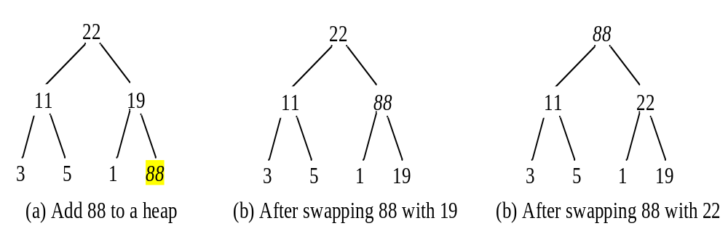
Rebuild the heap after adding a new node
Adding 88 to the heap

Slide 24
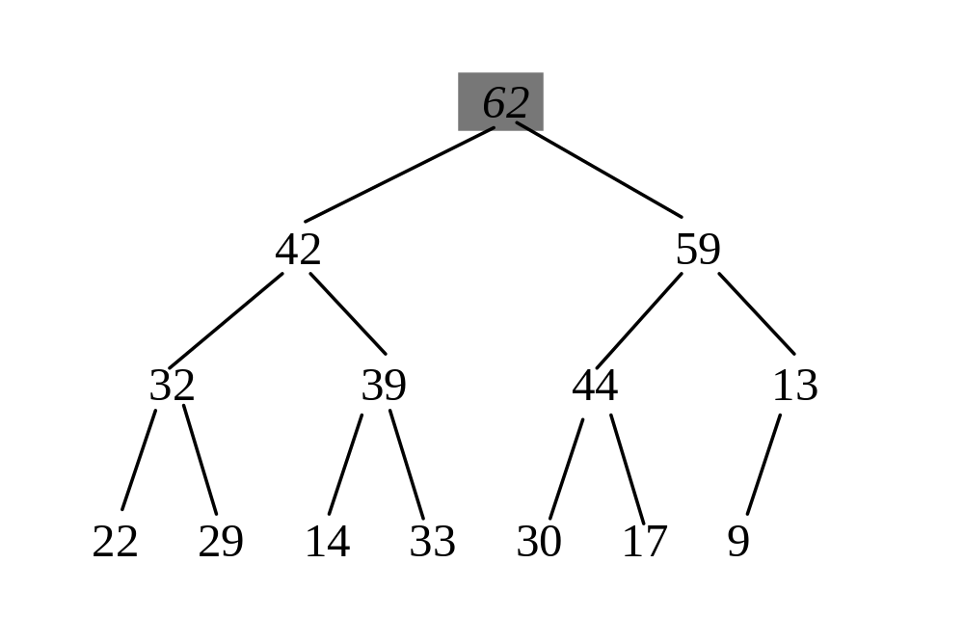
Removing the Root and Rebuild the Tree
Removing root 62 from the heap

Slide 25
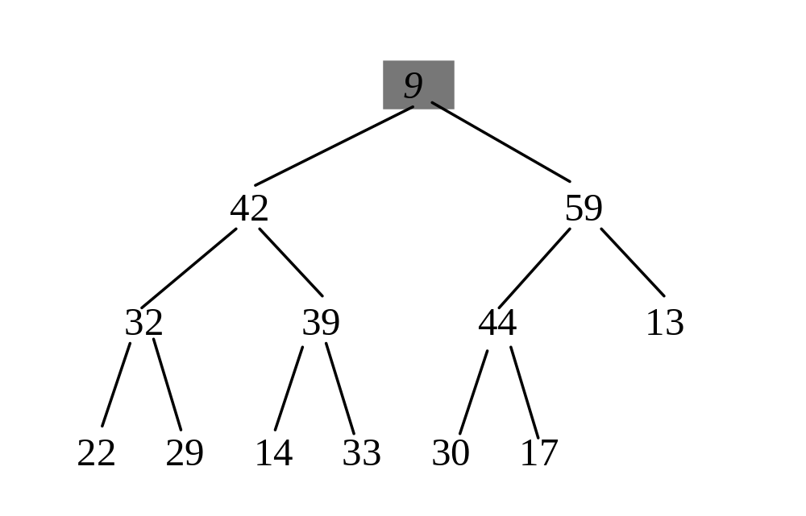
Removing the Root and Rebuild the Tree
Move 9 to root

Slide 26
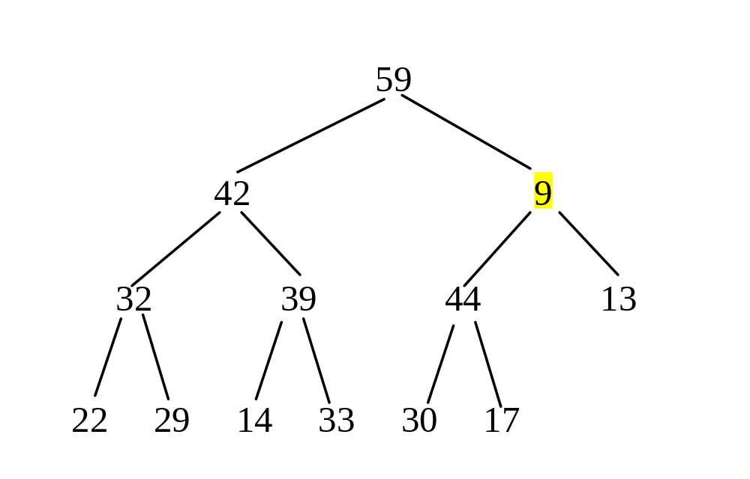
Removing the Root and Rebuild the Tree
Swap 9 with 59

Slide 27
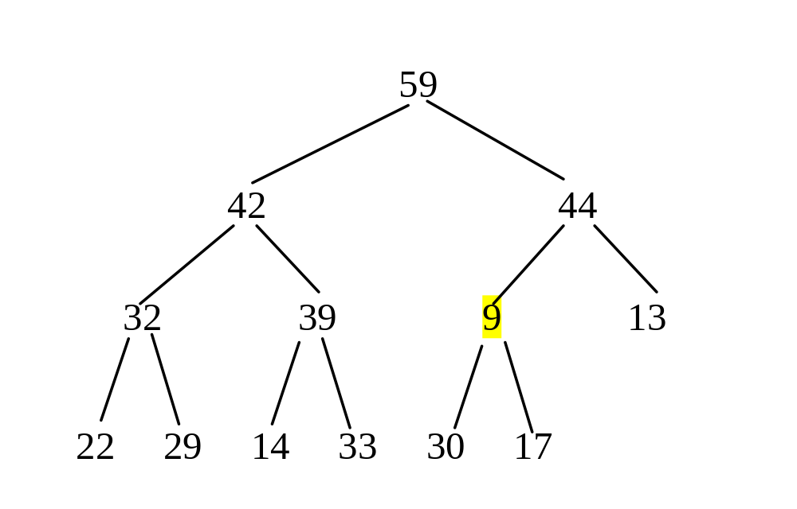
Removing the Root and Rebuild the Tree
Swap 9 with 44

Slide 28
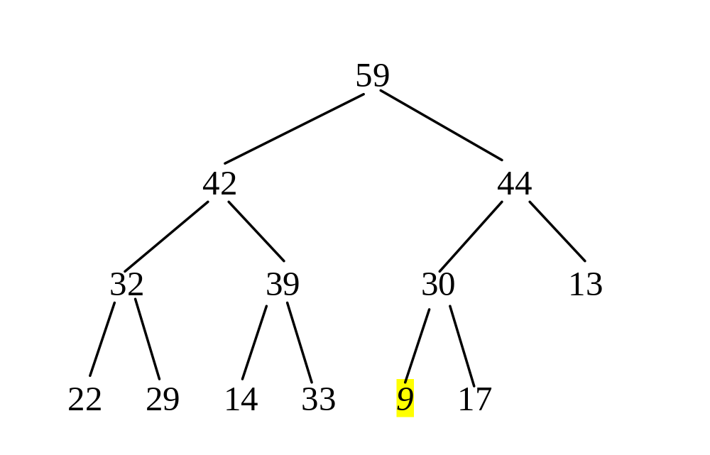
Removing the Root and Rebuild the Tree
Swap 9 with 30

Slide 29
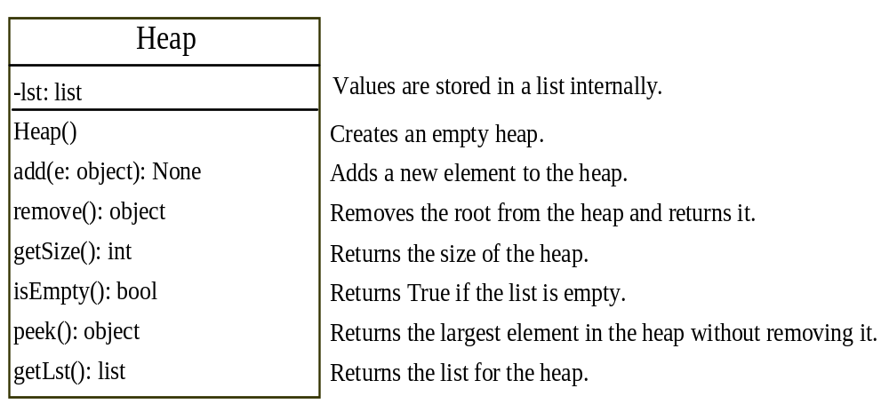
The Heap Class

Slide 30
class Heap:
def __init__(self):
self.__lst = []
# Add a new item into the lst
def add(self, e):
self.__lst.append(e) # Append to the lst
# The index of the last node
currentIndex = len(self.__lst) - 1
while currentIndex > 0:
parentIndex = (currentIndex - 1) // 2
# Swap if the current item is greater than its parent
if self.__lst[currentIndex] > self.__lst[parentIndex]:
self.__lst[currentIndex], self.__lst[parentIndex] = \
self.__lst[parentIndex], self.__lst[currentIndex]
else:
break # The tree is a lst now
currentIndex = parentIndex

Slide 31
# Remove the root from the lst
def remove(self):
if len(self.__lst) == 0:
return None
removedItem = self.__lst[0] # Store the root (to be removed)
# Replace root with the last item
self.__lst[0] = self.__lst[len(self.__lst) - 1]
self.__lst.pop(len(self.__lst) - 1) # Remove the last item
currentIndex = 0 # Start at the root index
while currentIndex < len(self.__lst): # Ensure the current node has children
leftChildIndex = 2 * currentIndex + 1 # Calculate left child index
rightChildIndex = 2 * currentIndex + 2 # Calculate right child index
# Find the maximum between two children
if leftChildIndex >= len(self.__lst):
break #If no left child exists, break out of the loop
maxIndex = leftChildIndex # Assume the left child is larger
if rightChildIndex < len(self.__lst): # If right child exists
if self.__lst[maxIndex] < self.__lst[rightChildIndex]:
maxIndex = rightChildIndex
# Swap if the current node is less than the maximum
if self.__lst[currentIndex] < self.__lst[maxIndex]:
self.__lst[maxIndex], self.__lst[currentIndex] = \
self.__lst[currentIndex], self.__lst[maxIndex]
currentIndex = maxIndex
else:
break # Exit if node is in correct position
return removedItem

Slide 32
# Returns the size of the heap
def getSize(self):
return len(self.__lst)
# Returns True if the heap is empty
def isEmpty(self):
return self.getSize() == 0
# Returns the largest element in the heap without removing it
def peek(self):
return self.__lst[0]
# Returns the list in the heap
def getLst(self):
return self.__lst

Slide 33
Heap Sort
from Heap import Heap
def heapSort(lst):
heap = Heap() # Create a Heap
# Add elements to the heap
for v in lst:
heap.add(v)
# Remove elements from the heap
for i in range(len(lst)):
lst[len(lst) - 1 - i] = heap.remove()
# Place removed element from heap into sorted position
def main():
lst = [-44, -5, -3, 3, 3, 1, -4, 0, 1, 2, 4, 5, 53]
heapSort(lst)
for v in lst:
print(v, end = " ") # Print sorted list
main()

